Slide 1
Chapter Eleven
Technology
技术

Slide 2
Structure
Describing technologies
  Production set or technology set
  Production function
  Isoquant
Marginal product
Returns to scale
Technical rate of substitution
Well-behaved technologies
Long run and short run

Slide 3
Technologies
A technology is a process by which inputs are converted to an output.
E.g. labor, a computer, a projector, electricity, and software are being combined to produce this lecture.

Slide 4
Technologies
Usually several technologies will produce the same product -- a blackboard and chalk can be used instead of a computer and a projector.
Which technology is “best”?
How do we compare technologies?

Slide 5
Input Bundles
x_{i} denotes the amount used of input i; i.e. the level of input i.
An input bundle is a vector of the input levels; (x₁, x₂, … , x_{n}).

Slide 6
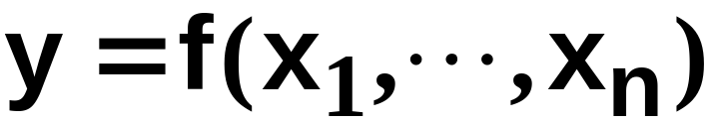
Production Functions (生产函数）
y denotes the output level.
The technology’s production function states the maximum amount of output possible from an input bundle.

Slide 7
Production Functions
One input, one output
Output Level
y = f(x) is the
production
function.
y’
y’ = f(x’) is the maximal output level obtainable from x’ input units.
x’
x
Input Level

Slide 8
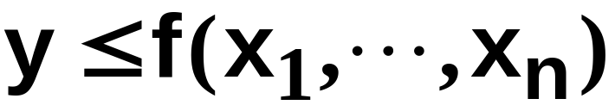
Technology Sets
A production plan is an input bundle and an output level; (x₁, … , x_{n}, y).
A production plan is feasible （可行）if
The collection of all feasible production plans is the production set (生产集) or technology set （技术集）.

Slide 9
Technology Sets
One input, one output
Output Level
y = f(x) is the
production
function.
y’
y’ = f(x’) is the maximal output level obtainable from x’ input units.
y”
y” = f(x’) is an output level that is feasible from x’ input units.
x’
x
Input Level

Slide 10
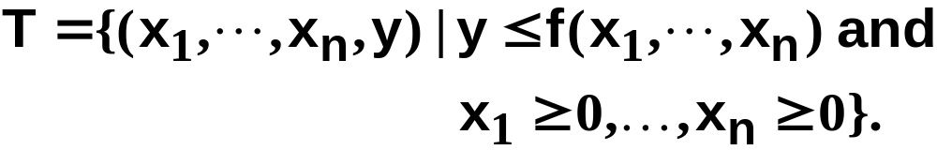
Technology Sets
The production set or technology set is

Slide 11
Technology Sets
One input, one output
Output Level
y’
The technology
set
y”
x’
x
Input Level

Slide 12
Technology Sets
One input, one output
Output Level
Technically
efficient plans
y’
The technology
set
Technically
inefficient
plans
y”
x’
x
Input Level

Slide 13
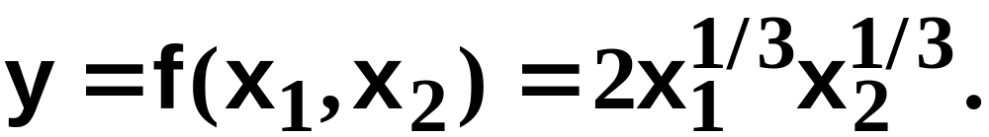
Technologies with Multiple Inputs
What does a technology look like when there is more than one input?
The two input case: Input levels are x₁ and x₂. Output level is y.
Suppose the production function is

Slide 14
Technologies with Multiple Inputs
E.g. the maximal output level possible from the input bundle
(x₁, x₂) = (1, 8) is
And the maximal output level possible from (x₁,x₂) = (8,8) is

Slide 15
Technologies with Multiple Inputs
An isoquant (等产量线) is the set of all possible combinations of inputs 1 and 2 that are just sufficient to produce a given amount of output.

Slide 16
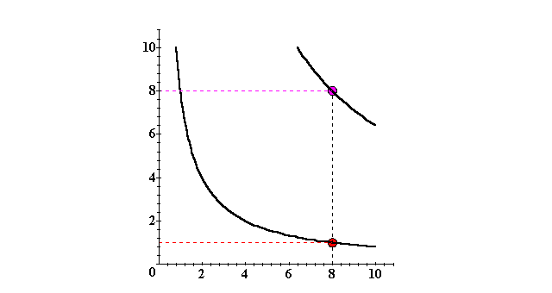
Isoquants with Two Variable Inputs
x₂
y ≡ 8
y ≡ 4
x₁

Slide 17
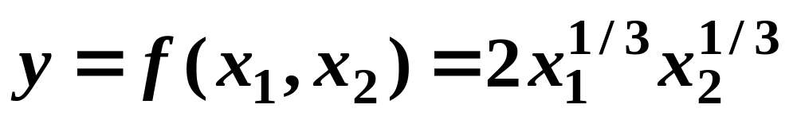
Technologies with Multiple Inputs
The complete collection of isoquants is the isoquant map.
The isoquant map is equivalent to the production function -- each is the other.
E.g.

Slide 18
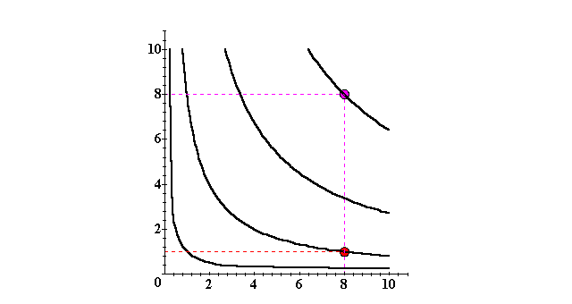
Isoquants with Two Variable Inputs
x₂
y ≡ 8
y ≡ 6
y ≡ 4
y ≡ 2
x₁

Slide 19
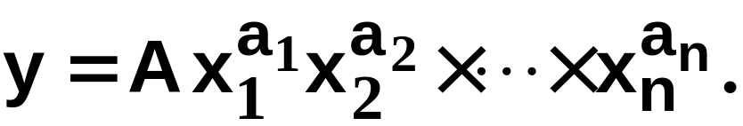
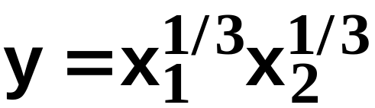
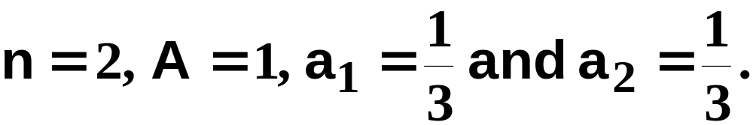
Cobb-Douglas Technologies
A Cobb-Douglas production function is of the form
E.g.
with

Slide 20
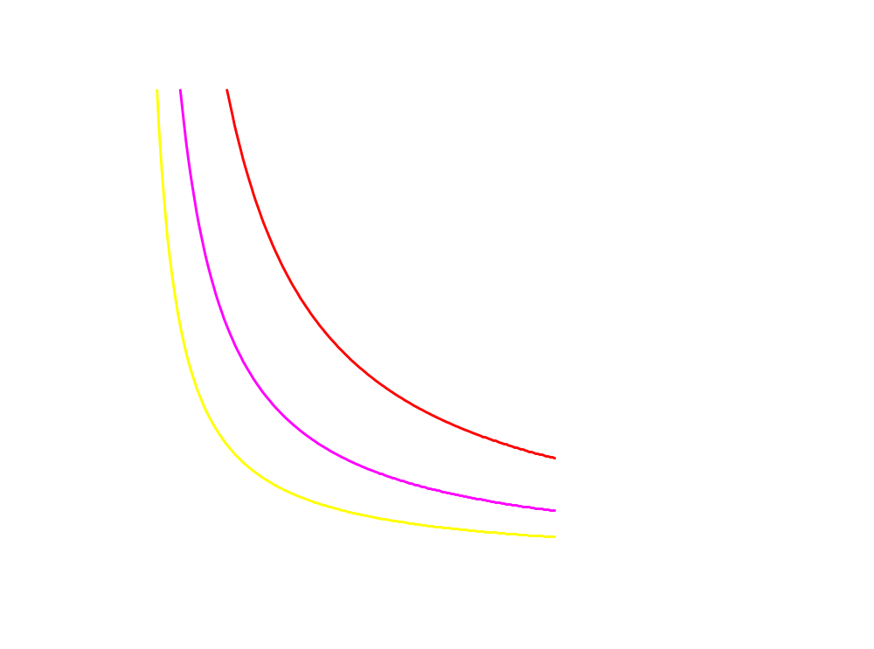
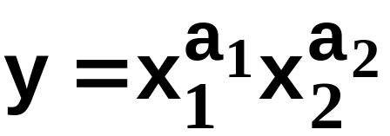
Cobb-Douglas Technologies
x₂
All isoquants are hyperbolic
(双曲线), asymptoting (渐进) to,
but never touching any axis.
x₁

Slide 21


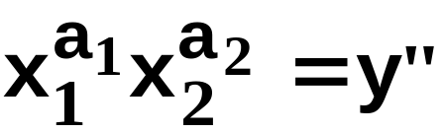
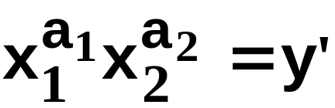
Cobb-Douglas Technologies
x₂
All isoquants are hyperbolic,
asymptoting to, but never
touching any axis.
>
x₁

Slide 22
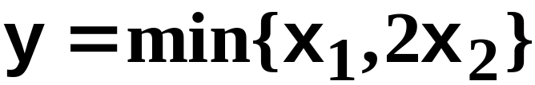
Fixed-Proportions Technologies
x₂
x₁ = 2x₂
7
min{x₁,2x₂} = 14
4
min{x₁,2x₂} = 8
2
min{x₁,2x₂} = 4
4
8
14
x₁

Slide 23
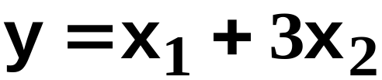
Perfect-Substitution Technologies
x₂
x₁ + 3x₂ = 18
x₁ + 3x₂ = 36
x₁ + 3x₂ = 48
8
6
All are linear and parallel
3
9
18
24
x₁

Slide 24

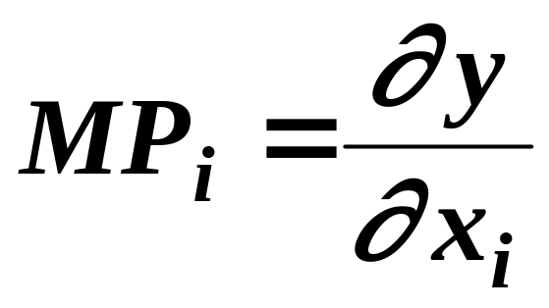
Marginal (Physical) Products
The marginal product (边际产量) of input i is the rate-of-change of the output level as the level of input i changes, holding all other input levels fixed.
That is,

Slide 25
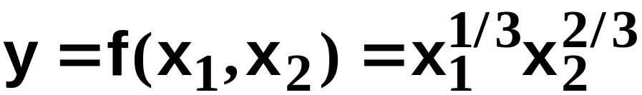
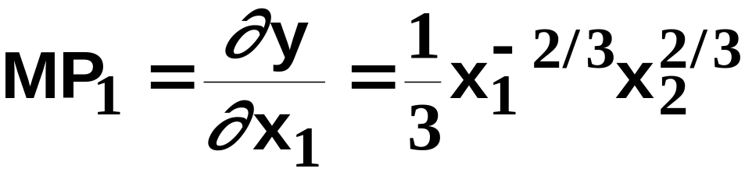
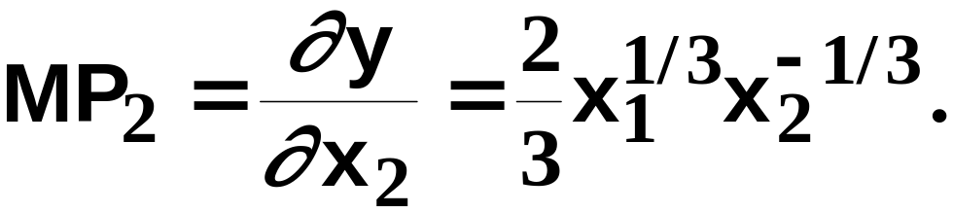
Marginal (Physical) Products
E.g. if
then the marginal product of input 1 is
and the marginal product of input 2 is

Slide 26
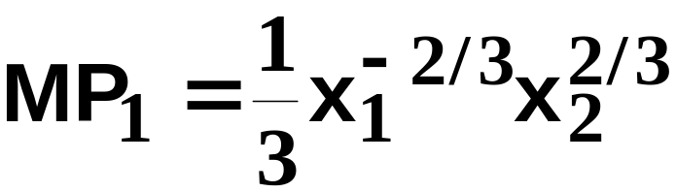
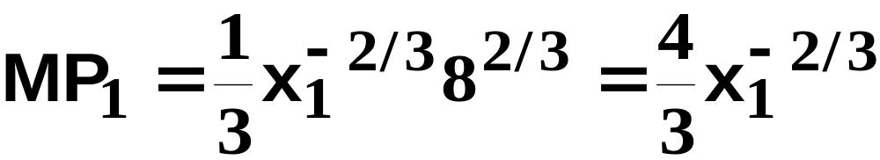
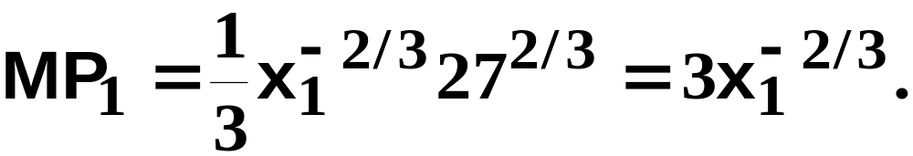
Marginal (Physical) Products
Typically the marginal product of one
input depends upon the amount used of other inputs. E.g. if
then,
if x₂ = 8,
and if x₂ = 27 then

Slide 27
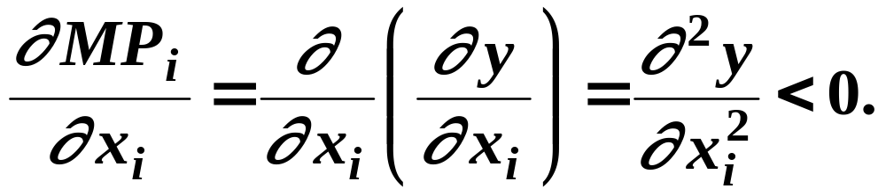
Marginal (Physical) Products
The marginal product of input i is diminishing if it becomes smaller as the level of input i increases. That is, if

Slide 28
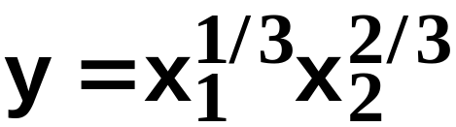
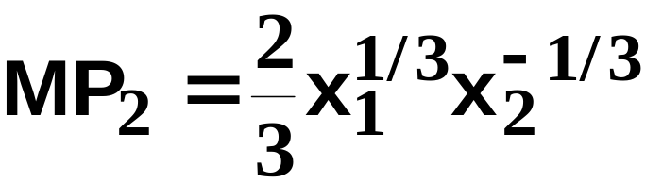
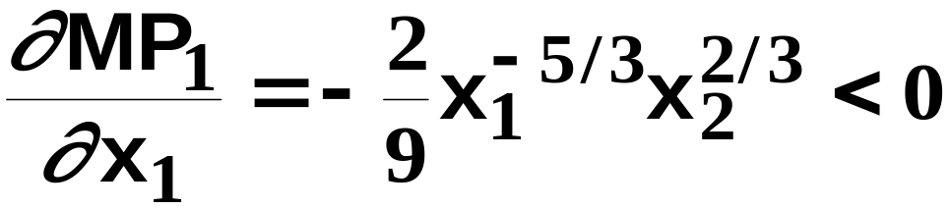
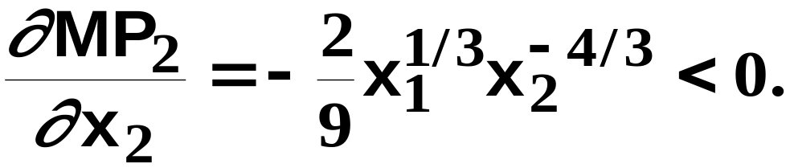
Marginal (Physical) Products
E.g. if
then
and
so
and
Both marginal products are diminishing.

Slide 29
Returns-to-Scale（规模收益）
Marginal products describe the change in output level as a single input level changes.
Returns-to-scale describes how the output level changes as all input levels change in direct proportion (e.g. all input levels doubled, or halved).

Slide 30
Returns-to-Scale
If, for any input bundle (x₁,…,x_{n}),
then the technology described by the
production function f exhibits constant
returns-to-scale（规模报酬不变）.
E.g. (k = 2) doubling all input levels
doubles the output level.

Slide 31
Returns-to-Scale
One input, one output
Output Level
y = f(x)
2y’
Constant
returns-to-scale
y’
x’
2x’
x
Input Level

Slide 32
Returns-to-Scale
If, for any input bundle (x₁,…,x_{n}),
then the technology exhibits diminishing
returns-to-scale （规模报酬递减）.
E.g. (k = 2) doubling all input levels less
than doubles the output level.

Slide 33
Returns-to-Scale
One input, one output
Output Level
2f(x’)
y = f(x)
f(2x’)
Decreasing
returns-to-scale
f(x’)
x’
2x’
x
Input Level

Slide 34
Returns-to-Scale
If, for any input bundle (x₁,…,x_{n}),
then the technology exhibits increasing
returns-to-scale （规模报酬递增）.
E.g. (k = 2) doubling all input levels
more than doubles the output level.

Slide 35
Returns-to-Scale
One input, one output
Output Level
Increasing
returns-to-scale
y = f(x)
f(2x’)
2f(x’)
f(x’)
x’
2x’
x
Input Level

Slide 36
Returns-to-Scale
A single technology can ‘locally’ exhibit different returns-to-scale.

Slide 37
Returns-to-Scale
One input, one output
Output Level
y = f(x)
Increasing
returns-to-scale
Decreasing
returns-to-scale
x
Input Level

Slide 38
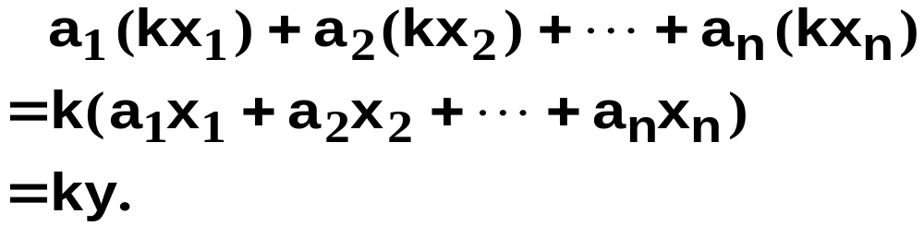
Examples of Returns-to-Scale
The perfect-substitutes production
function is
Expand all input levels proportionately
by k. The output level becomes
The perfect-substitutes production
function exhibits constant returns-to-scale.

Slide 39
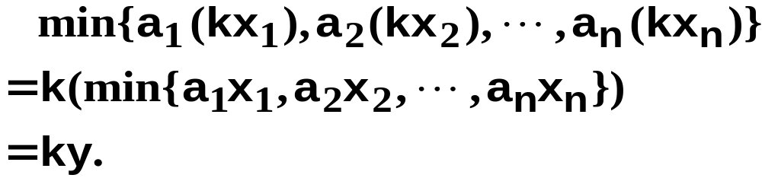
Examples of Returns-to-Scale
The perfect-complements production
function is
Expand all input levels proportionately
by k. The output level becomes
The perfect-complements production
function exhibits constant returns-to-scale.

Slide 40
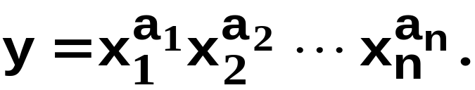
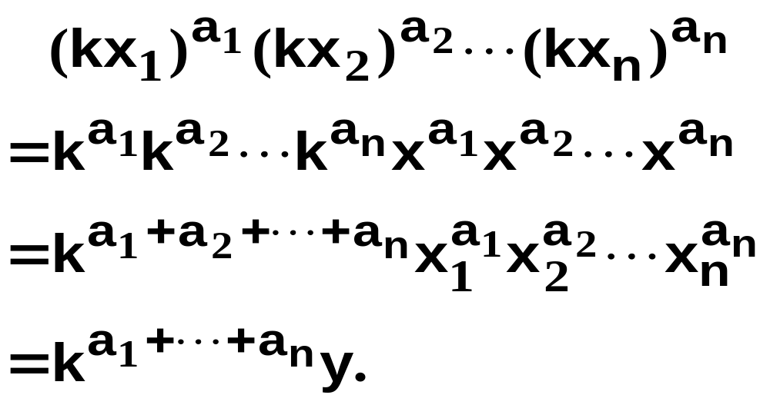
Examples of Returns-to-Scale
The Cobb-Douglas production function is
Expand all input levels proportionately
by k. The output level becomes

Slide 41
Examples of Returns-to-Scale
The Cobb-Douglas production function is
The Cobb-Douglas technology’s returns-
to-scale is
constant if a₁+ … + a_{n} = 1
increasing if a₁+ … + a_{n} > 1
decreasing if a₁+ … + a_{n} < 1.

Slide 42
Returns-to-Scale
Q: Can a technology exhibit increasing returns-to-scale even though all of its marginal products are diminishing?

Slide 43
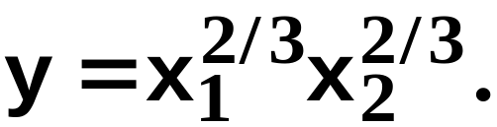
Returns-to-Scale
Q: Can a technology exhibit increasing returns-to-scale even if all of its marginal products are diminishing?
A: Yes.
E.g.

Slide 44
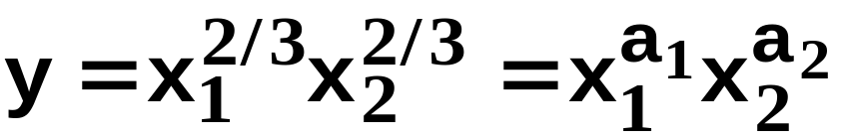
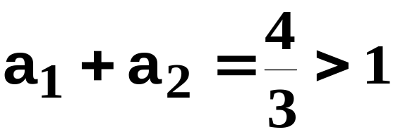
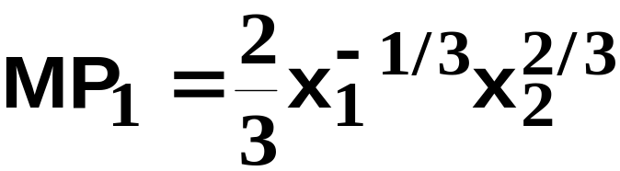
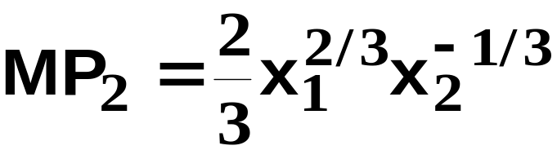
Returns-to-Scale
so this technology exhibits
increasing returns-to-scale.
But
diminishes as x₁
increases and
diminishes as x₁
increases.

Slide 45
Returns-to-Scale
A marginal product is the rate-of-change of output as one input level increases, holding all other input levels fixed.
Marginal product diminishes because the other input levels are fixed, so the increasing input’s units have each less and less of other inputs with which to work.

Slide 46
Returns-to-Scale
When all input levels are increased proportionately, there need be no diminution of marginal products since each input will always have the same amount of other inputs with which to work. So returns-to-scale can be constant or increasing.

Slide 47
Technical Rate-of-Substitution
(技术替代率)
At what rate can a firm substitute one input for another without changing its output level?

Slide 48


Technical Rate-of-Substitution
x₂
y≡100
x₁

Slide 49
Technical Rate-of-Substitution
The slope is the rate at which input 2 must be given up as input 1’s level is increased so as not to change the output level. The slope of an isoquant is its technical rate-of-substitution.
x₂
y≡100
x₁

Slide 50
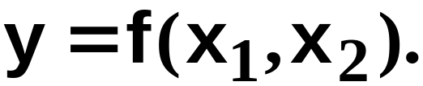
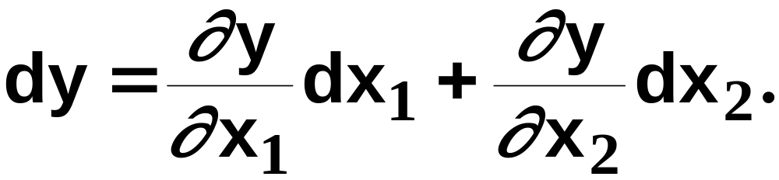
Technical Rate-of-Substitution
How is a technical rate-of-substitution computed?
The production function is
A small change (dx₁, dx₂) in the input bundle causes a change to the output level of

Slide 51
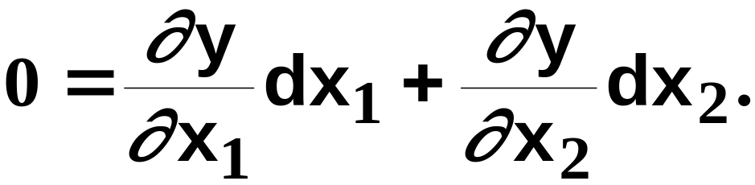
Technical Rate-of-Substitution
But dy = 0 since there is to be no change
to the output level, so the changes dx₁
and dx₂ to the input levels must satisfy

Slide 52
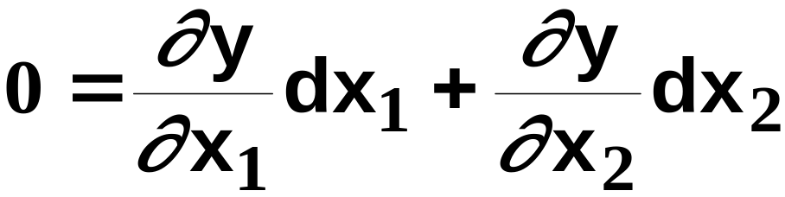
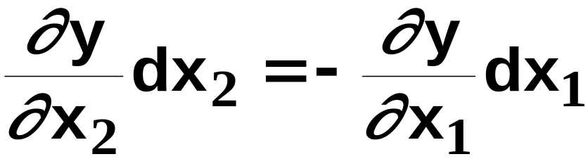
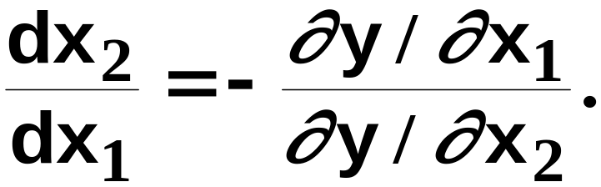
Technical Rate-of-Substitution
rearranges to
so

Slide 53
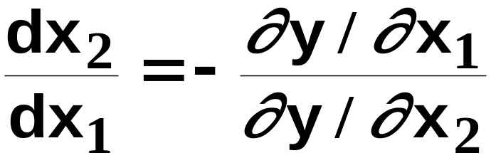
Technical Rate-of-Substitution
is the rate at which input 2 must be given
up as input 1 increases so as to keep
the output level constant. It is the slope
of the isoquant.

Slide 54
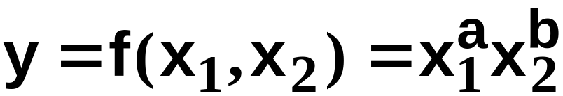
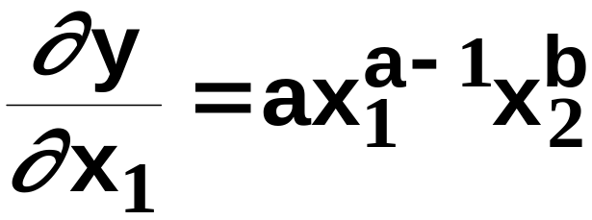
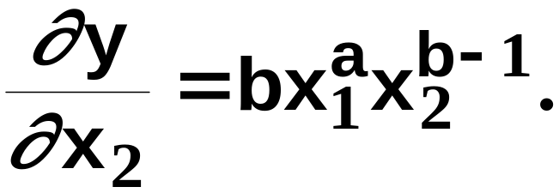
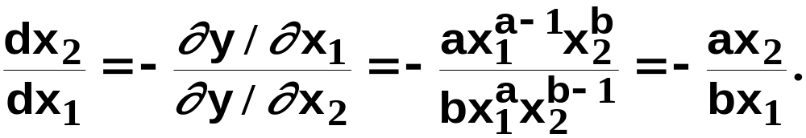
Technical Rate-of-Substitution; A Cobb-Douglas Example
so
and
The technical rate-of-substitution is

Slide 55
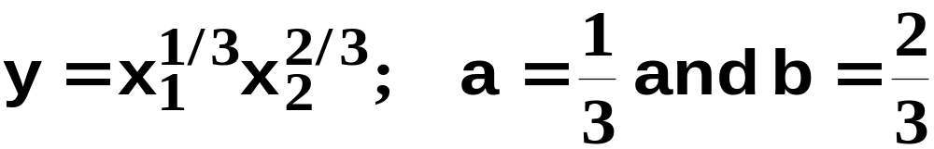
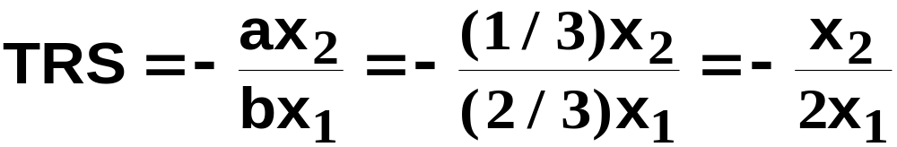
Technical Rate-of-Substitution; A Cobb-Douglas Example
x₂
x₁

Slide 56

Technical Rate-of-Substitution; A Cobb-Douglas Example
x₂
8
4
x₁

Slide 57

Technical Rate-of-Substitution; A Cobb-Douglas Example
x₂
6
12
x₁

Slide 58
Well-Behaved Technologies
A well-behaved technology is
  monotonic, and
  convex.

Slide 59
Well-Behaved Technologies - Monotonicity
Monotonicity: More of any input generates more output.
y
y
monotonic
not
monotonic
x
x

Slide 60
Well-Behaved Technologies - Convexity
Convexity: If the input bundles x’ and x” both provide y units of output then the mixture tx’ + (1-t)x” provides at least y units of output, for any 0 < t < 1.

Slide 61


Well-Behaved Technologies - Convexity
x₂
y≡100
x₁

Slide 62

Well-Behaved Technologies - Convexity
x₂
y≡100
x₁

Slide 63
Well-Behaved Technologies - Convexity
x₂
y≡120
y≡100
x₁

Slide 64
Well-Behaved Technologies - Convexity
x₂
Convexity implies that the TRS
increases (becomes less
negative) as x₁ increases.
x₁

Slide 65
Well-Behaved Technologies – Monotonicity and convexity
higher output
x₂
y≡200
y≡50
y≡100
x₁

Slide 66
The Long-Run and the Short-Runs
The long-run is the circumstance in which a firm is unrestricted in its choice of all input levels.
There are many possible short-runs.
A short-run is a circumstance in which a firm is restricted in some way in its choice of at least one input level.

Slide 67
The Long-Run and the Short-Runs
Examples of restrictions that place a firm into a short-run:
  temporarily being unable to install, or remove, machinery

Slide 68
The Long-Run and the Short-Runs
What do short-run restrictions imply for a firm’s technology?
Suppose the short-run restriction is fixing the level of input 2.
Input 2 is thus a fixed input in the short-run. Input 1 remains variable.

Slide 69

The Long-Run and the Short-Runs
y
x₁
Four short-run production functions.

Slide 70



The Long-Run and the Short-Runs
is the long-run production
function (both x₁ and x₂ are variable).
The short-run production function when
x₂ ≡ 1 is
The short-run production function when
x₂ ≡ 10 is

Slide 71




The Long-Run and the Short-Runs
y
x₁
Four short-run production functions.

